Slide 1




Slide 2

TEAM MATES
Bhavya Bhatt
Aditya Singh
Ishaan Sehrawat

Slide 3
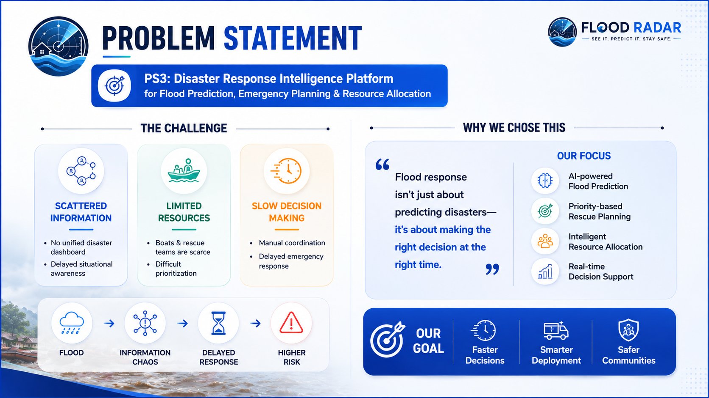
PROBLEM STATEMENT
PS3: Disaster response intelligence platform for flood prediction, emergency planning and resource allocation.
We chose this problem because flood response requires fast, data-driven decisions, yet resources are often limited and information is scattered. Our solution goes beyond predicting floods by identifying who needs help first and where resources should be deployed, making disaster response faster, smarter, and more effective.

Slide 4
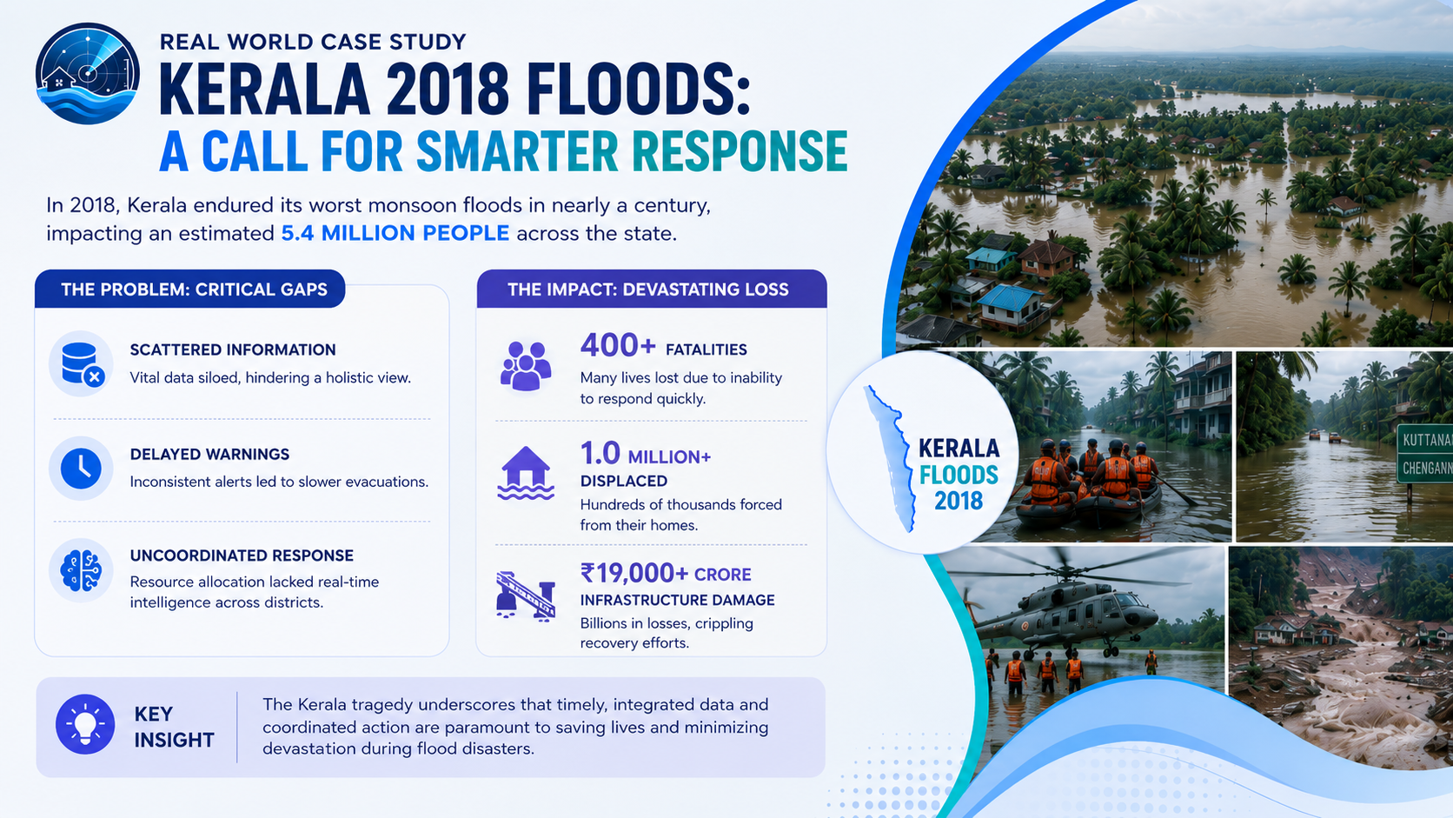
400+

Slide 5
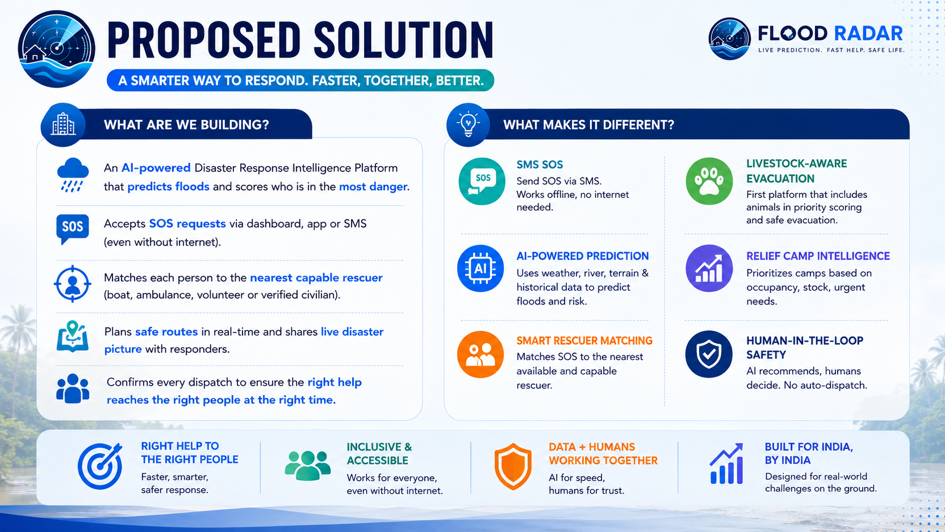

Slide 6
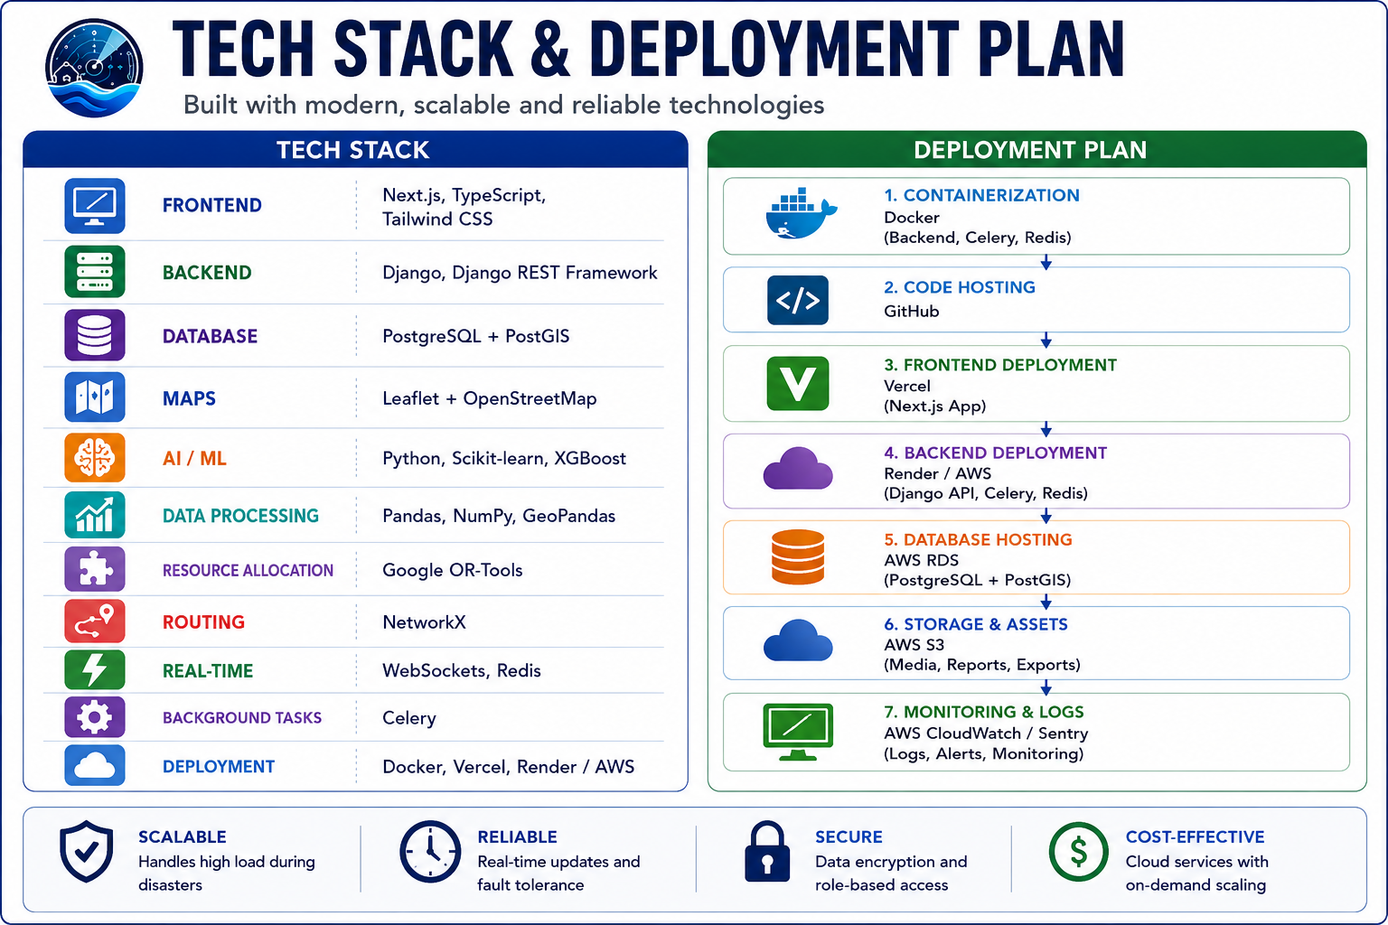

Slide 7
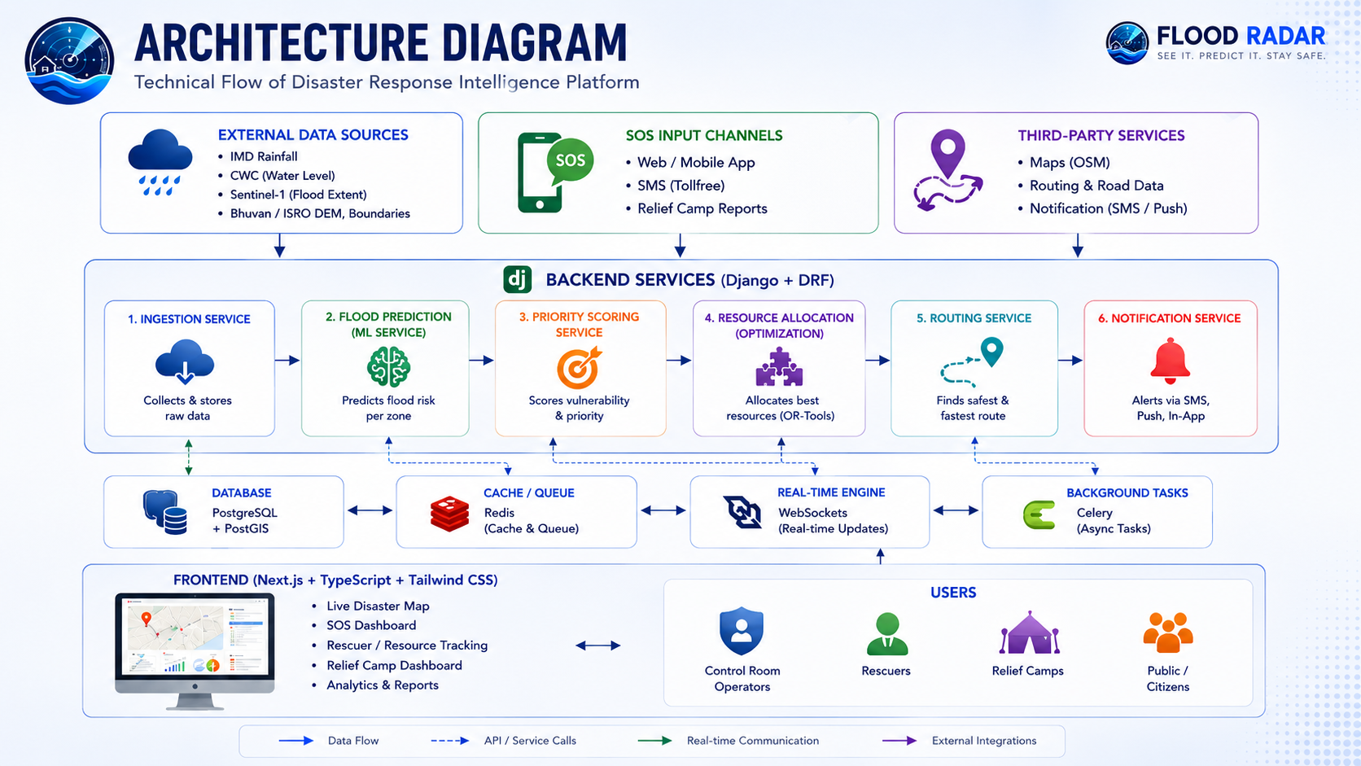

Slide 8
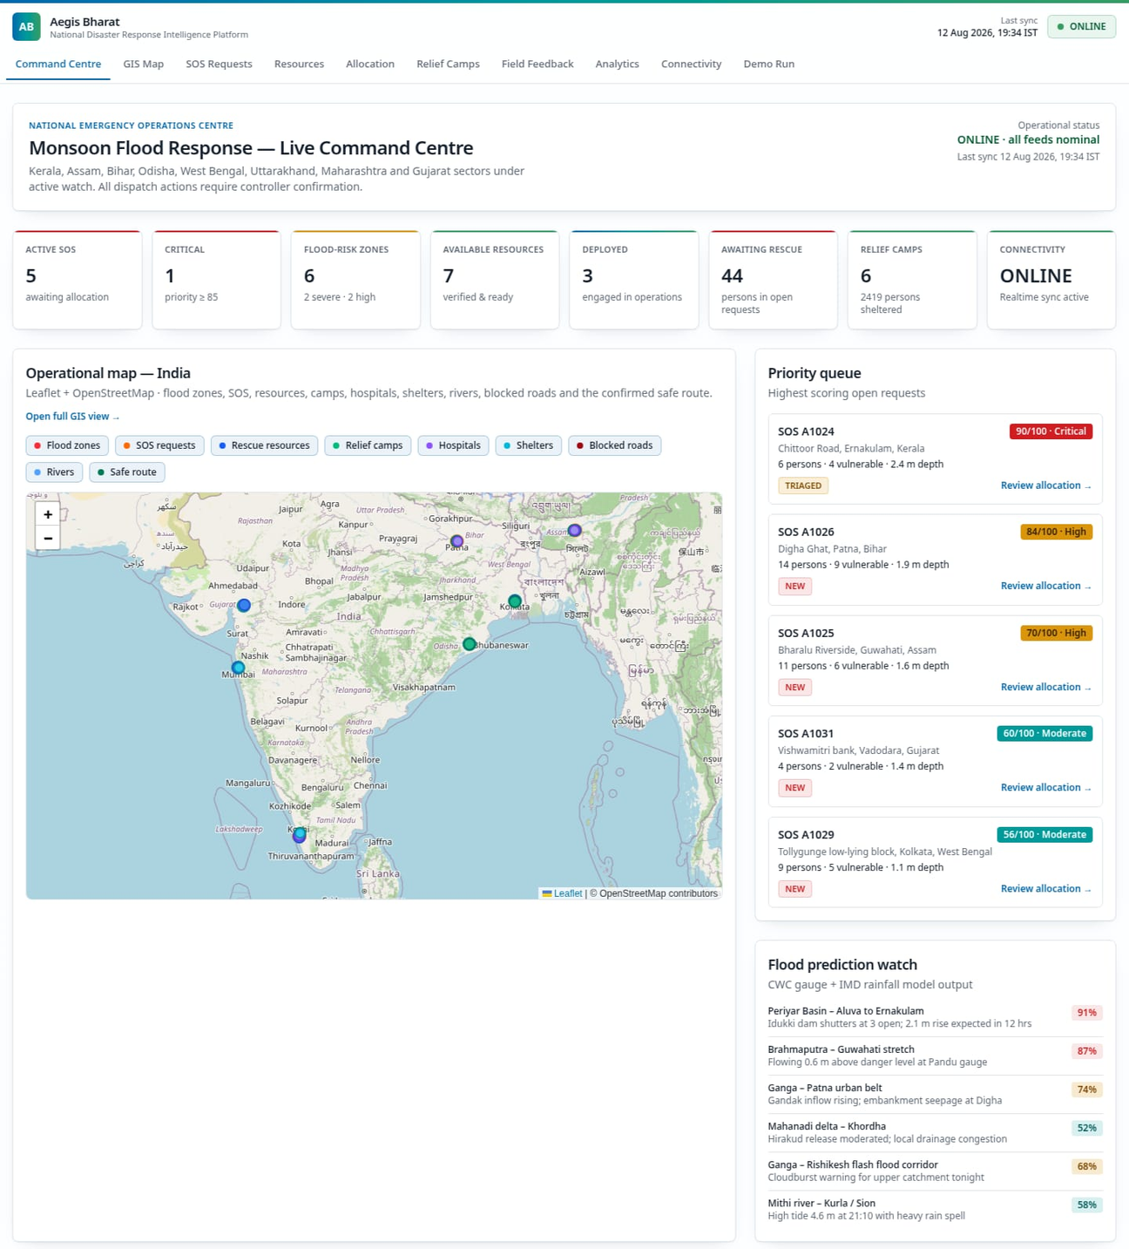
Website Interface

Slide 9
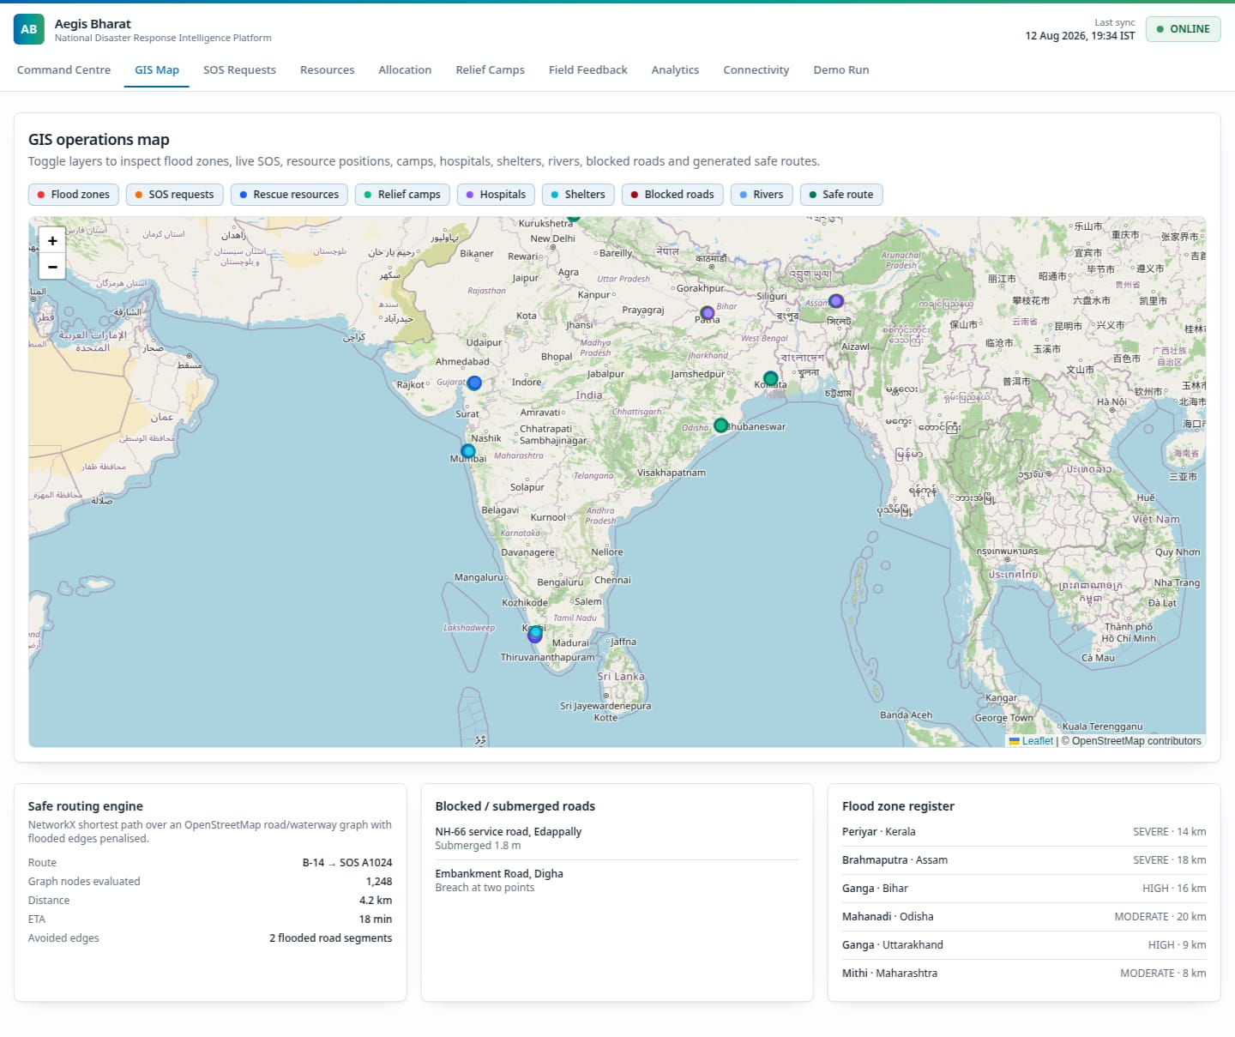

Slide 10
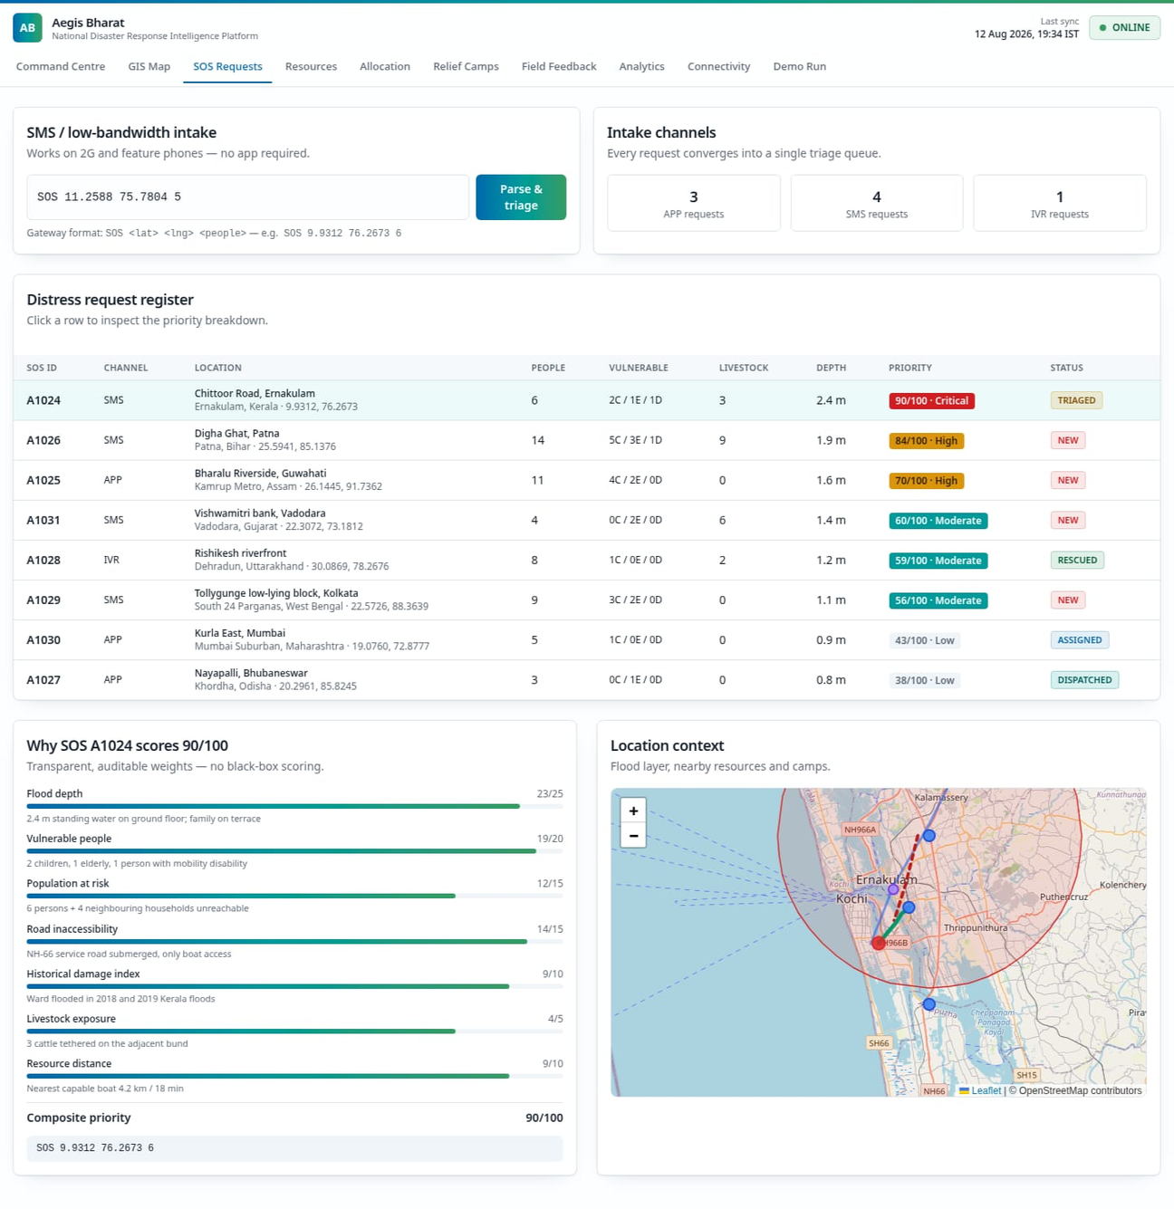

Slide 11
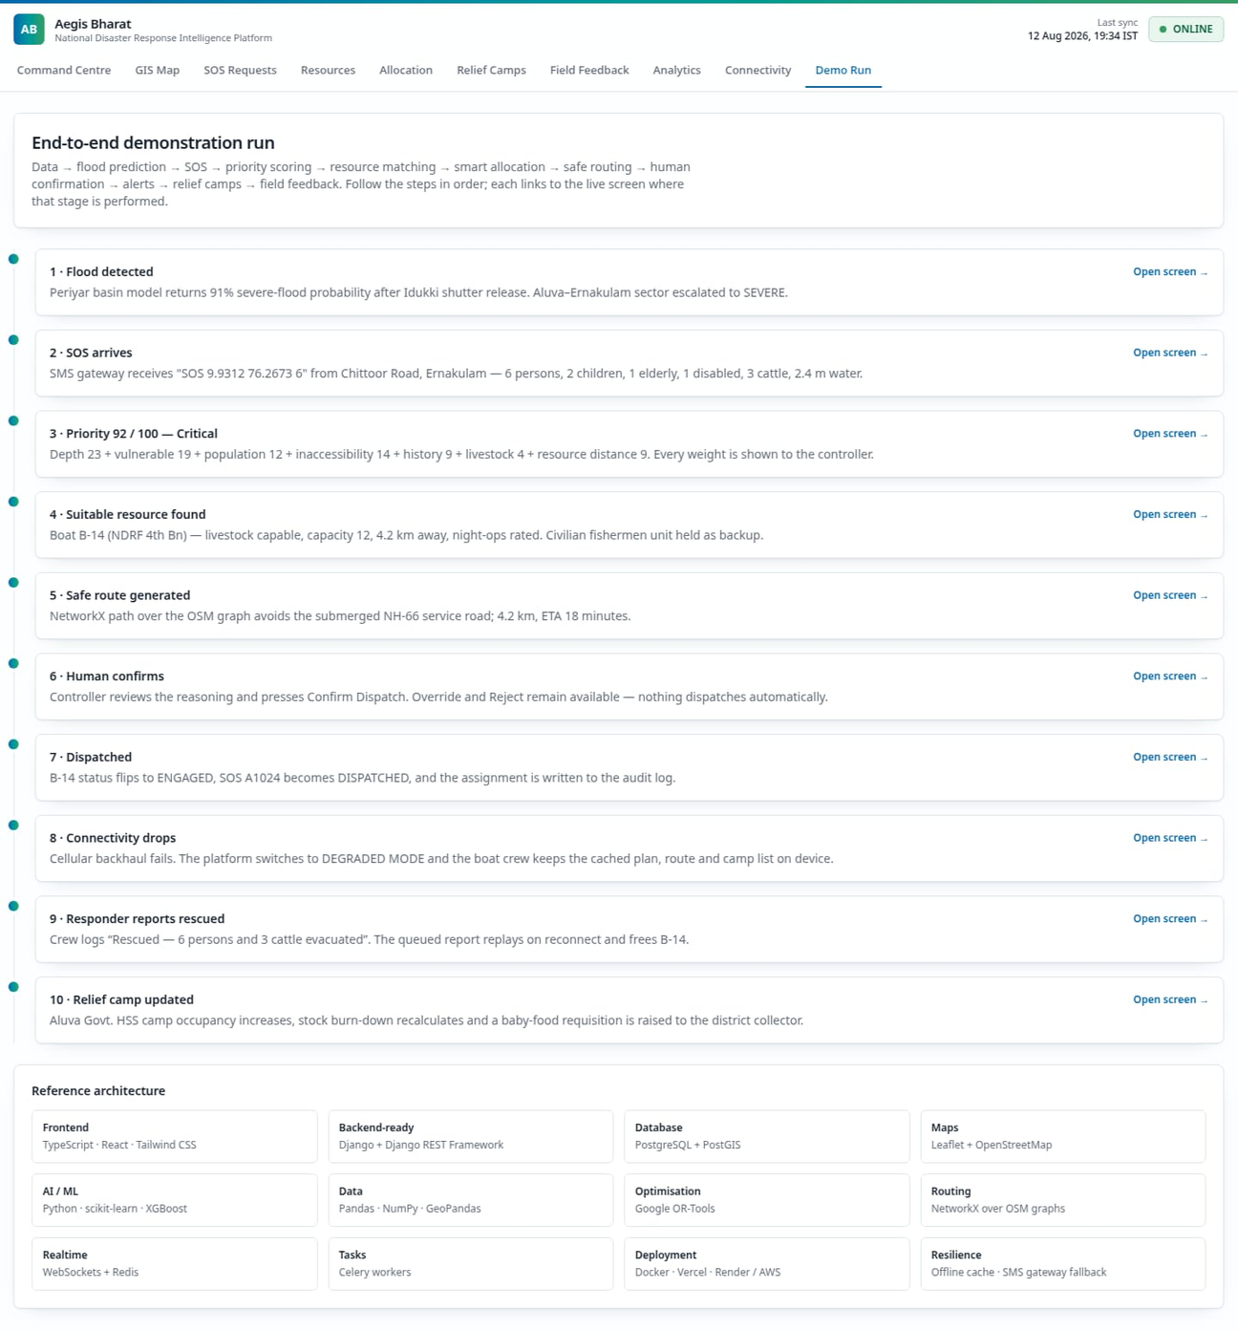

Slide 12

THANK YOU

